Slide 1



GOOGLE CLOUD
DATA ANALYTICS
Presented By
Vidwath Surya T|4VV22CS182

Slide 2


INTRODUCTION
Cloud computing is a transformative technology that enables individuals and organizations to access computing resources such as storage, processing power, and applications over the internet on a pay-as-you-go basis. Unlike traditional IT infrastructures that require significant upfront investment and ongoing maintenance, cloud platforms offer scalable, flexible, and cost-effective solutions that can be tailored to dynamic business needs. By leveraging cloud service models like Infrastructure as a Service (IaaS), Platform as a Service (PaaS), and Software as a Service (SaaS), users can build, deploy, and manage applications more efficiently. Google Cloud, one of the leading providers, offers a comprehensive suite of tools to support modern data analytics, machine learning, and enterprise-grade computing with global reliability and robust security.

Slide 3
Traditional Data Warehouse
Cloud Data Warehouse
Traditional Data Warehouse Cloud Data Warehouse Hosted on-premises, requiring internal teams to manage hardware, software, and security.
Scaling requires manual upgrades—new servers, storage, and configuration.
High upfront capital for infrastructure and licenses, with fixed capacity.
Fully managed by providers like Google Cloud or AWS. For instance, an e-commerce company can use BigQuery without managing any infrastructure.
Instantly scalable to meet fluctuating demand. For example, streaming services scale up storage and compute automatically during peak hours.
Pay-as-you-go pricing model. For example, a startup only pays for the queries it runs on BigQuery, making it cost-efficient as it grows.

Slide 4
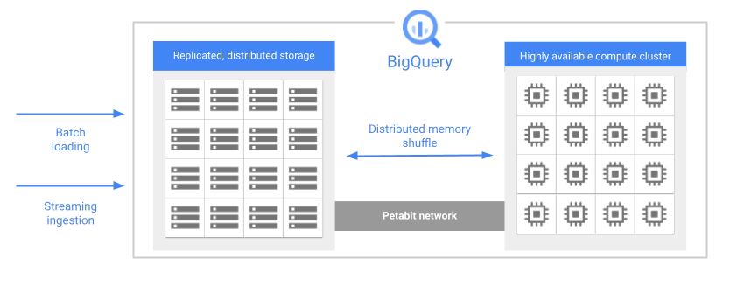
BigQuery is a serverless, scalable cloud data warehouse enabling fast SQL queries and pay-per-use analytics without infrastructure management.
BigQuery Architecture

Slide 5
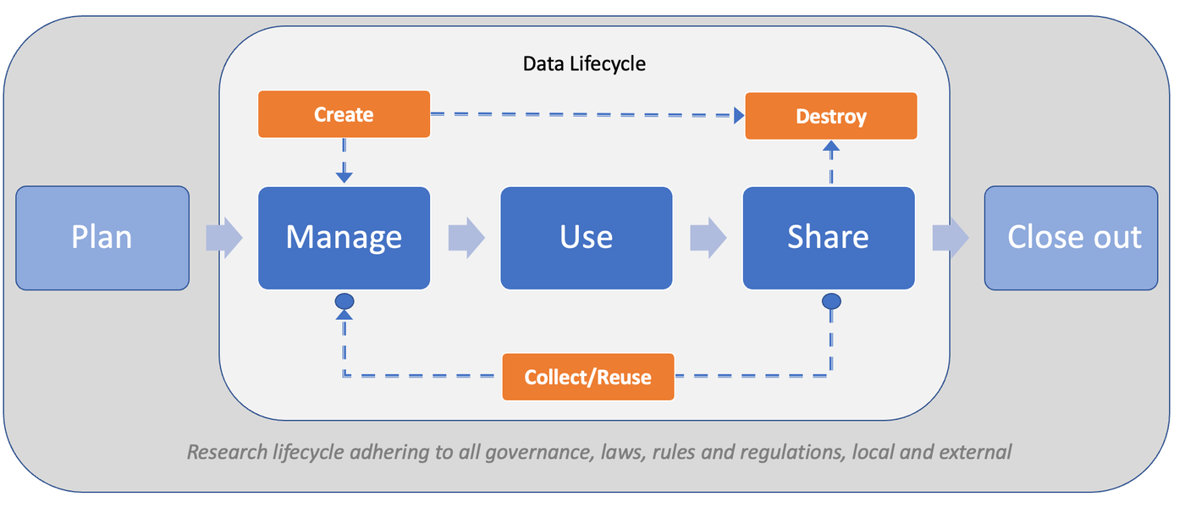
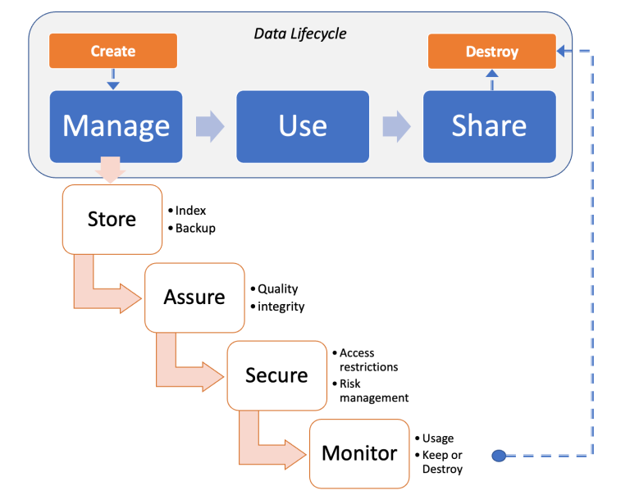
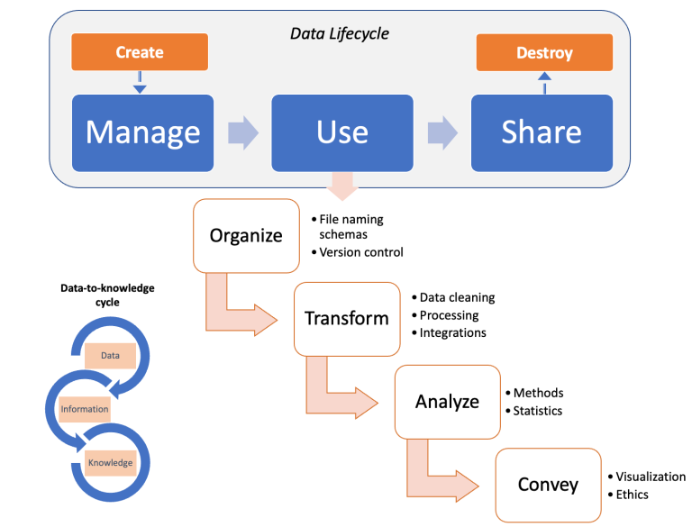
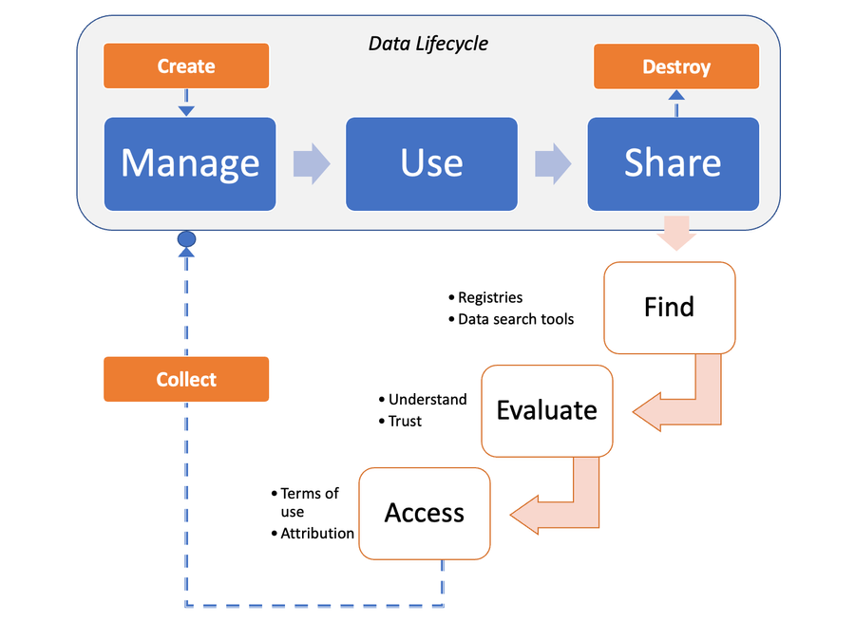

Slide 6
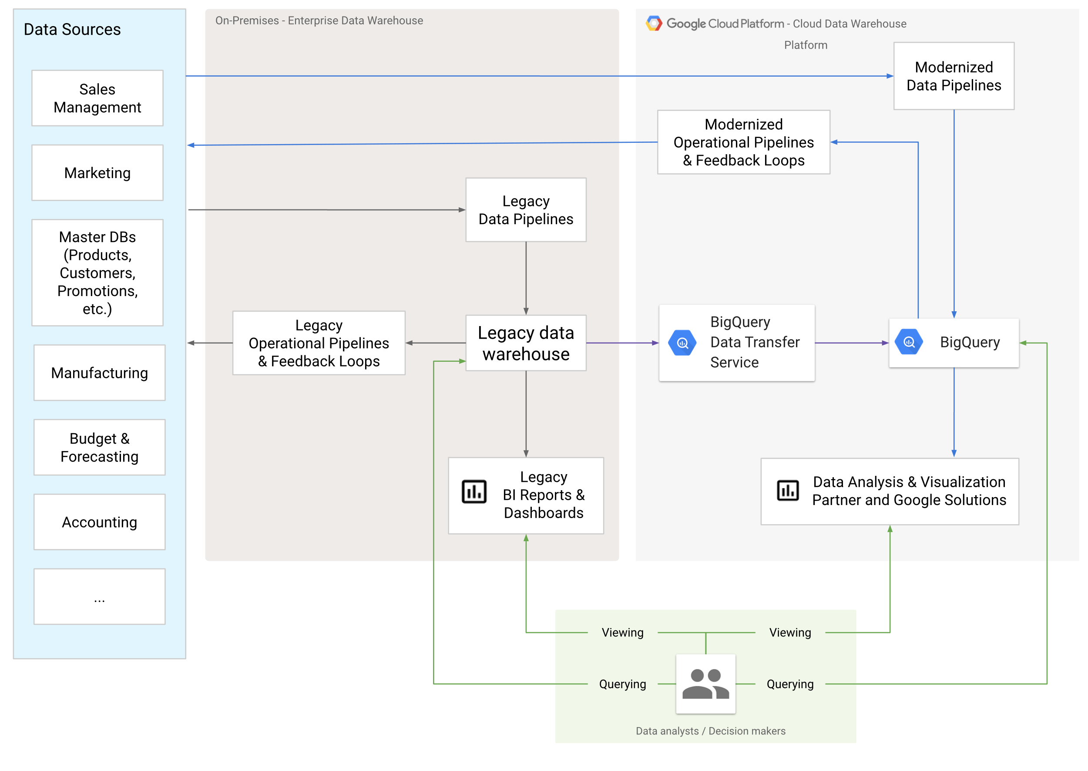

Slide 7
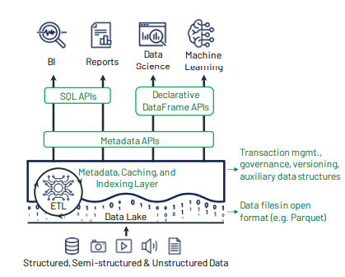
A data lakehouse is a modern data architecture that combines the features of both data lakes and data warehouses. It allows organizations to store all types of data—structured, semi-structured, and unstructured—on low-cost storage, while enabling users to perform a wide range of analytics tasks. From business intelligence to machine learning and AI, a data lakehouse provides a unified platform where data can be organized, explored, and leveraged flexibly according to user needs.

Slide 8
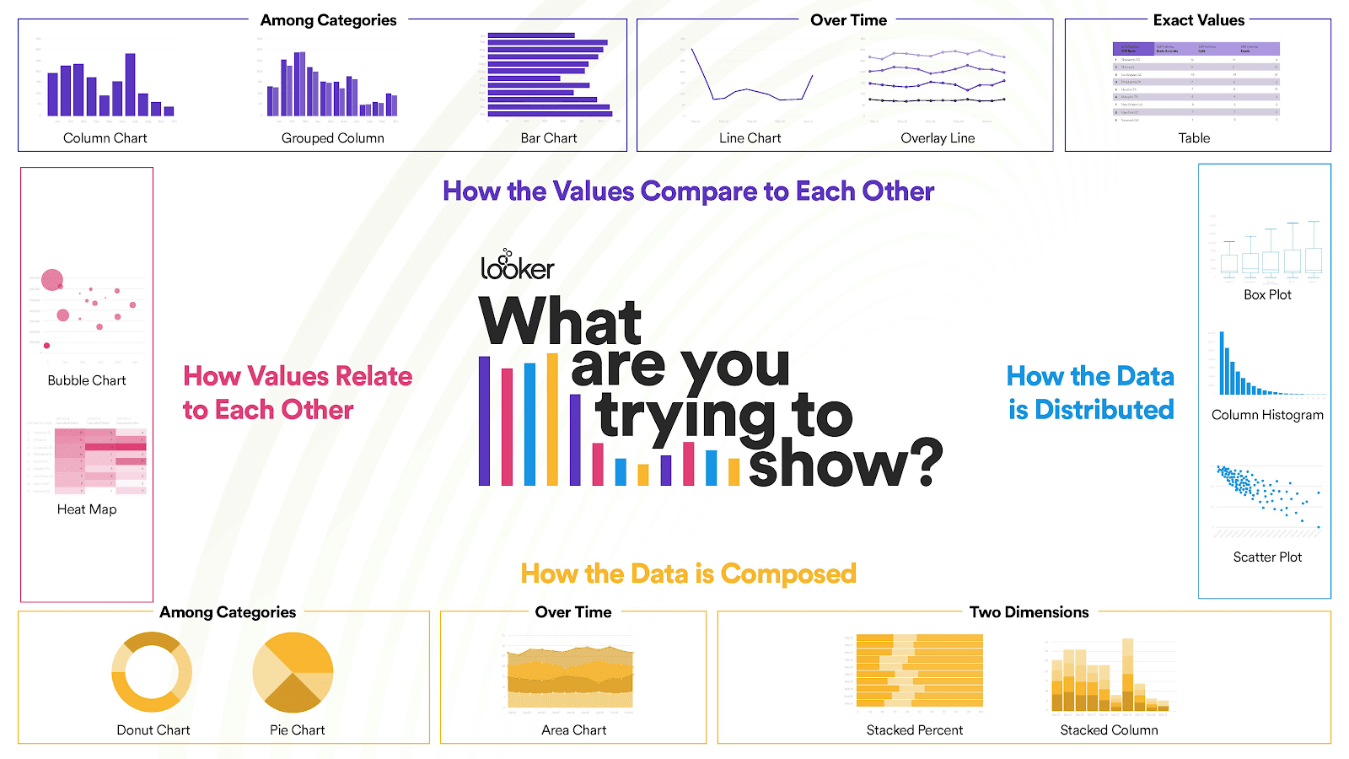

Slide 9
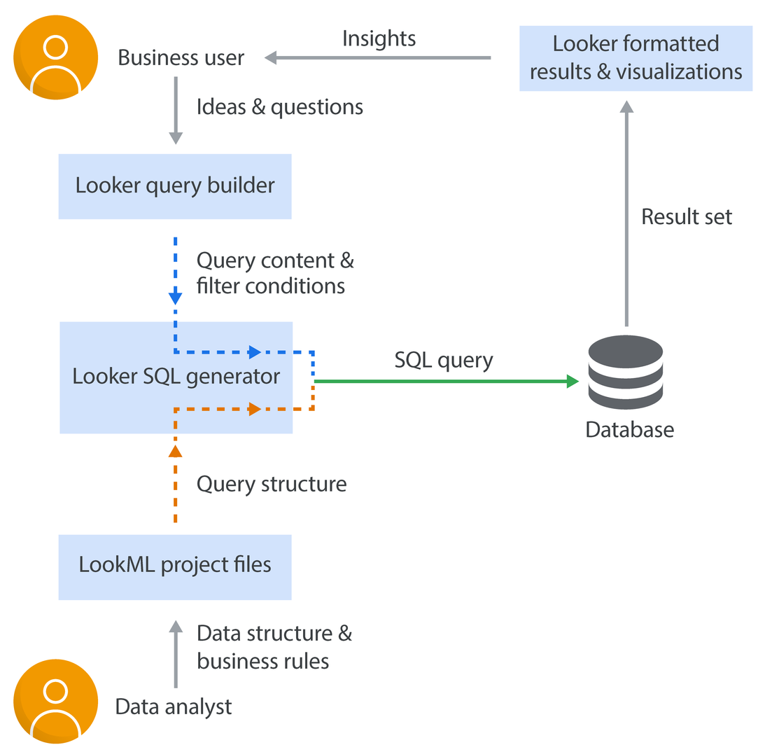
LookML (Looker Modeling Language) is a declarative language used in Looker to create semantic data models by describing dimensions, measures, calculations, and relationships within SQL databases. It allows data analysts to define data logic once using the DRY (Don't Repeat Yourself) principle, enabling reusable and consistent SQL generation. Unlike traditional programming languages, LookML is a dependency language—simple to learn and independent of specific SQL dialects. When business users create queries using the Explore interface, Looker translates those selections into SQL using the underlying LookML model. The SQL is then executed against the database, and the results are returned as interactive, visual insights. This separation of logic and exploration empowers business users to generate insights without needing to understand SQL or data structure complexities.

Slide 10
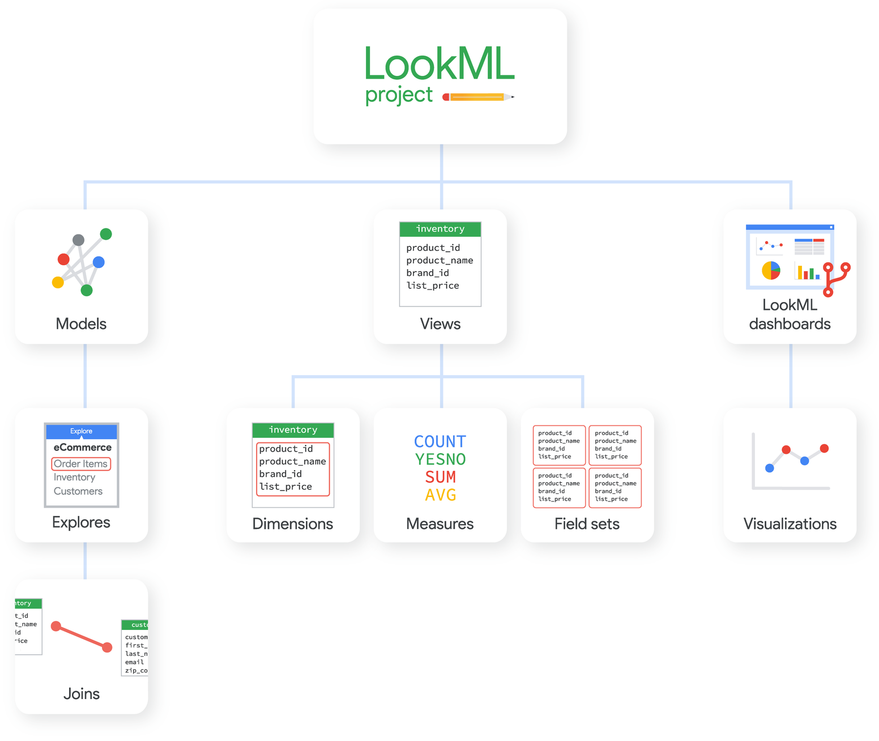
Parts of a LookML Project

Slide 11


Thank You

